Slide 1
Chapter 20: Transaction

Slide 2
Introduction to Transaction Processing
Reality:
Most of the time, computer systems do not fail
But, from time to time, a computer system can fail
Facts
Financial applications (e.g., banking) often use database systems to process their transactions
Computer failures have detrimental consequences in financial applications
See example:

Slide 3
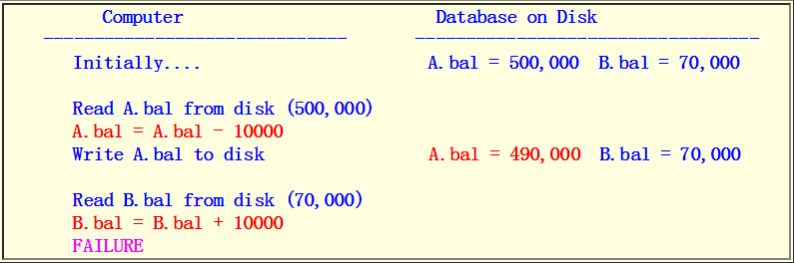

Introduction to Transaction Processing (cont.)
Example:
Customer A transfers the sum of $10,000 to the account of customer B
Suppose the computer system fails in the middle of the transfer operation:
Result:

Slide 4
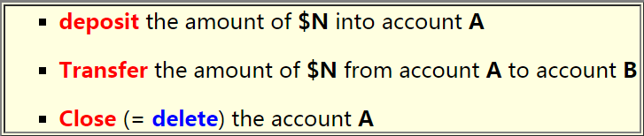
Transaction
A transaction is a "logical unit of execution in database processing"
Examples of transactions:

Slide 5
Properties of Transaction
Properties:
ACID properties: Atomicity, Consistency preservation, Isolation, Durability or Permanency
Atomicity
A transaction is an atomic unit of data processing
In other words: a transaction is either performed in its entirety or not performed at all
Consistency preservation:
A transaction is consistency preserving if its complete execution takes the database from one consistent state to another consistent state

Slide 6
Properties of Transaction (cont.)
Isolation
Although transactions are executed concurrently, each transaction should appear as though it is being executed in isolation from other transactions.
In other words: the execution of a transaction should not be interfered with by other transactions executing at the same time.

Slide 7
Properties of Transaction (cont.)
Durability or permanency:
The changes made to the database by a successful transaction must persist in the database
In other words: the changes must not be lost because of possible failure occurring immediately after the transaction

Slide 8
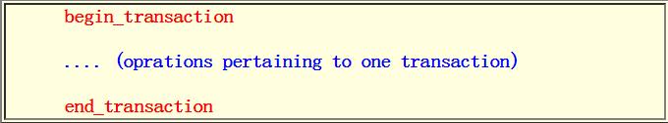
Denoting a Transaction
We use the keywords begin_transaction and end_transaction to delimit the operations that pertain to one transaction
Graphically
Transaction = a block of operations between begin_transaction and end_transaction

Slide 9
Transaction Modelling
The operations that are defined on a data item are:
read_item(X): read the data item named X
write_item(X): write the data item named X
See example:
I will use a integer value as data item in the example below to explain the operations

Slide 10
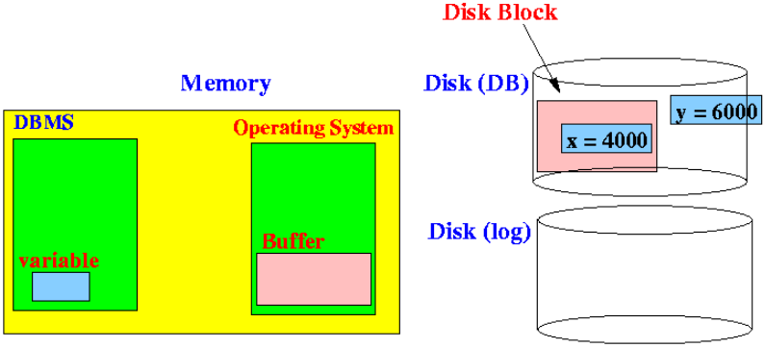
What happens in the read_item(x) operation
Locate the disk block that contains the data item x:

Slide 11
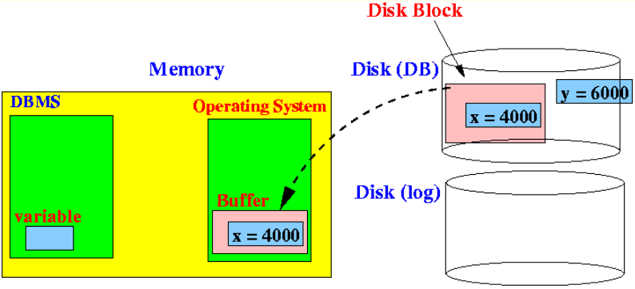
What happens in the read_item(x) operation (cont.)
Read (copy) the disk block that contains the data item x into a system buffer (inside the Operating System):
(In other words: the entire disk block is read in (not just the data item x !!!)

Slide 12
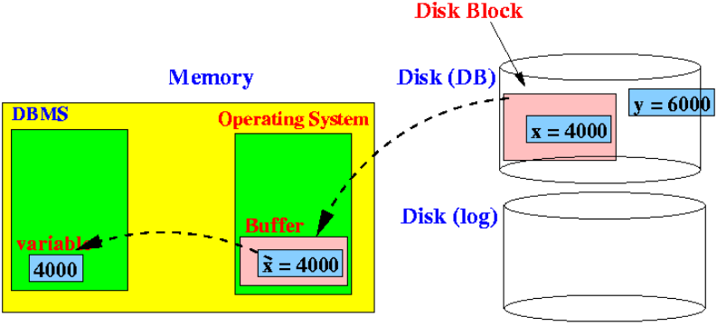
What happens in the read_item(x) operation (cont.)
Read (copy) the data item x from the Operating System buffer into a program variable inside the DBMS:

Slide 13
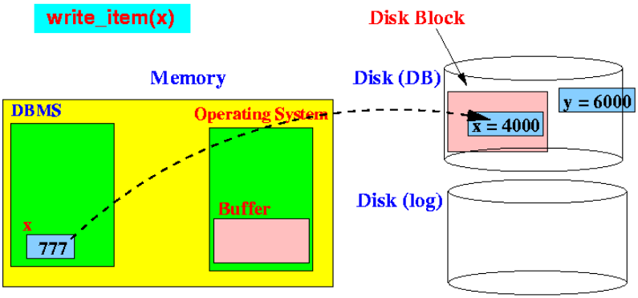
What happens in the write_item(x) operation (cont.)
Note that the DBMS variable x will be used to update the data item x in the database:
Note: The x in write_item(x) refers to the memory variable x (with value 777) !!!

Slide 14
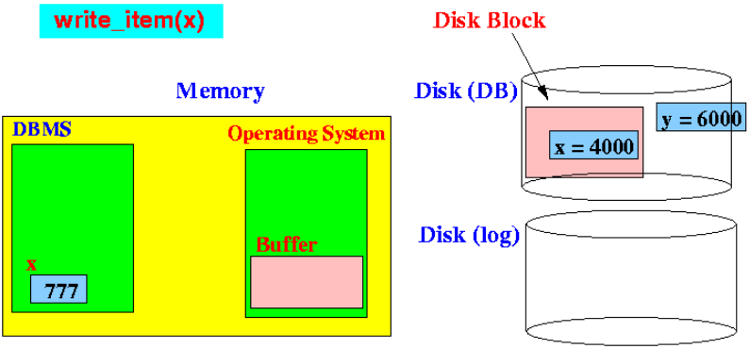
What happens in the write_item(x) operation (cont.)
Locate the disk block that contains the data item x

Slide 15
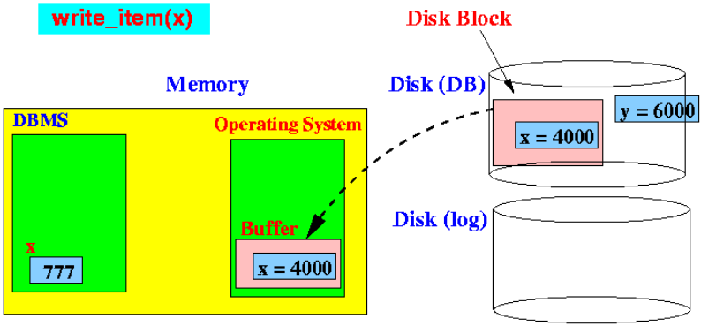
What happens in the write_item(x) operation (cont.)
Read (copy) the disk block that contains the data item x into a system buffer (inside the Operating System):

Slide 16
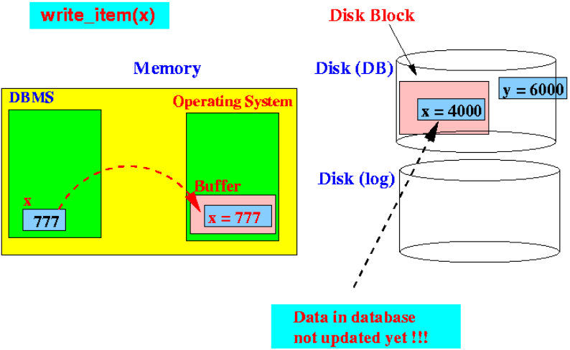
What happens in the write_item(x) operation (cont.)
Write (copy) the value:
Note: the data item x inside the database has not been updated yet !!!

Slide 17
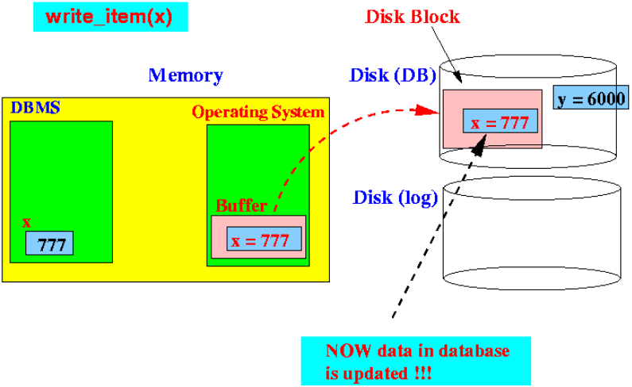
What happens in the write_item(x) operation (cont.)
Write (copy) the disk block to disk:
Note: now the data item x is updated !!!

Slide 18
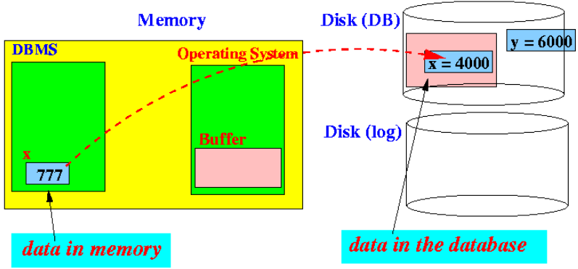
In-Place Write and Deferred Write
Recall that: A transaction consists of many operations
In particular:
A transaction consists of many write operations.
When a transaction updates a variable in memory, the update must eventually be written to the database:

Slide 19
In-Place Write and Deferred Write (cont.)
Important fact:
We have a choice to select the moment in time when the updates to the memory variables will be written to the database
Timing of issuing/executing a write operation:
There are 2 commonly used moments to issue write operations:

Slide 20
In-Place Write and Deferred Write (cont.)
In-place write: Immediately (as soon as the memory variable is updated, the change is written to the data in the database)
The rationale for this choice is the fact that we want to make the new value available to other transactions as soon as possible
Deferred write: At the end of the transaction
The rationale for this choice is the fact that the same variable may be updated multiple times within one transaction
This scheme will be more efficient

Slide 21
In-Place Write and Deferred Write (cont.)
In-place (or immediate) write:
In place (or immediate) write = a write operation to the database is issued as soon as a memory variable is updated
Deferred write:
Deferred write = all write operations to the database are issued at the end of the transaction

Slide 22
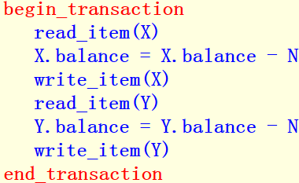
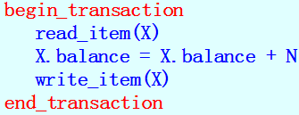
Transactions: examples
Example 1 of a transaction: transfer an amount of $N from account X to account Y:
Example 2 of a transaction: deposit an amount of $N into the account X:
+

Slide 23
What Can Go Wrong in Transaction Processing
Fact: A database system is used concurrently by multiple users
I.e.: Multiple transactions are processed concurrently
Possible results of concurrent execution of database transactions:
lost updates
Dirty read
Either of these situations will cause inconsistency in the database system

Slide 24
Lost Update
Lost update:
An update is lost if after executing a transaction, the result of the transaction is not reflected in the final database state
An example of a concurrent execution of database transactions that results in a lost update:

Slide 25
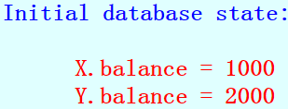
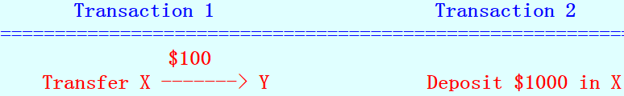
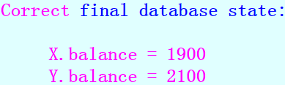
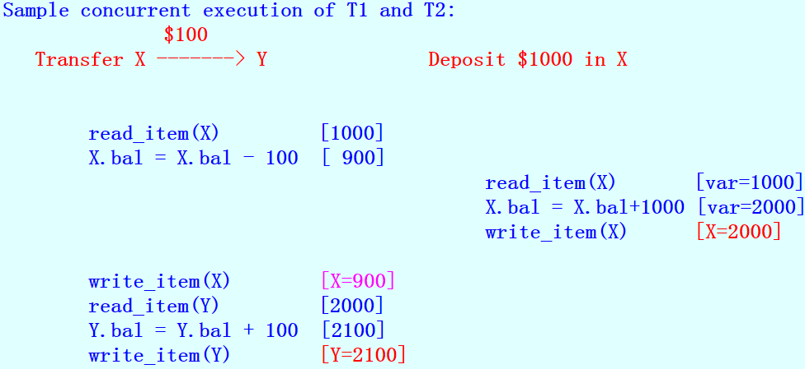

Slide 26
Lost Update (cont.)
Result:
After this concurrent execution of transactions, the update of transaction T2 is lost!!!

Slide 27
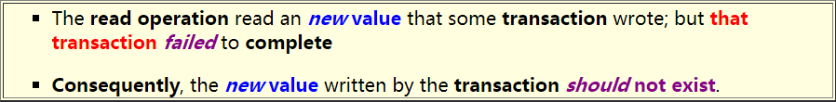
Dirty Read
Dirty read:
A dirty read operation is a read operation that obtained an illegal value
An illegal value is a value that does not exit in the database
Clarification:
You may wonder how on earth can a read operation read a value that does not exist
Well, the matter is a bit complicated. What actually happened is:

Slide 28
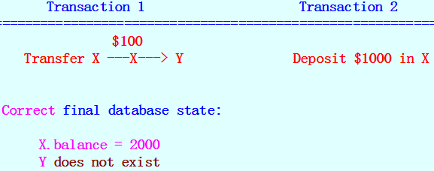

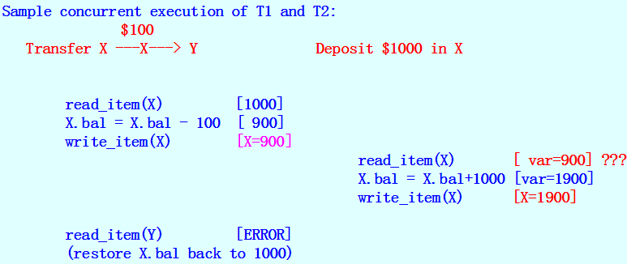
An example of concurrent execution of database transactions
Results in a dirty read operation

Slide 29

Dirty Read (cont.)
Result:
When the execution of transaction T1 detects that Y is invalid, the read operation of transaction T2 becomes a dirty read !!!
Because:

Slide 30

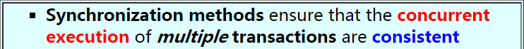
Implementing Transaction Processing
Techniques used to implement transactions:
Logging: logging ensures that all operations in a transaction are either:
Synchronization methods:

Slide 31
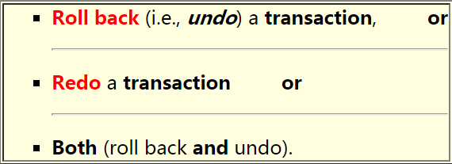
Implementing Transaction Processing using Undo Logs
General:
Implementing transaction requires maintaining log information of each update operation executed by transactions
Transaction log:
An append only file consists of entries called log records
The information stored in the transaction log will enable the database system to:

Slide 32
Implementing Transaction Processing using Undo Logs (cont.)
Idea of Undo:
In order to undo the updates made by the transaction, we save the original (old) value of every updated data item !!!

Slide 33
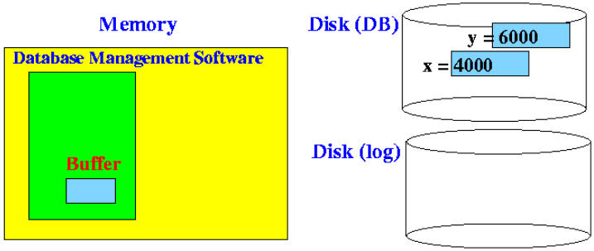
Example Transaction Processing Using In-place Write and UNDO Logs
Consider a simple transaction T that updates a value x:
E.g. transfer $1000 from account x to y
Initially, the database state is as follows:
T: X = X – 1000
Y = Y + 1000

Slide 34
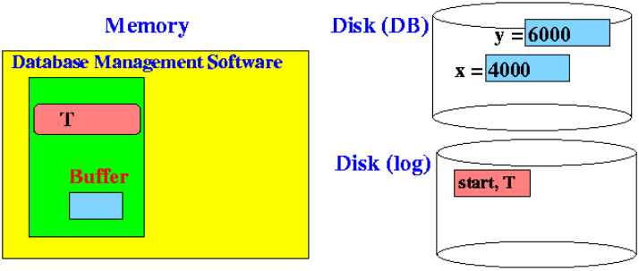
Transaction Processing is as Follows
Step 1: When transaction T starts, the transaction processing system writes a start transaction to log file:

Slide 35
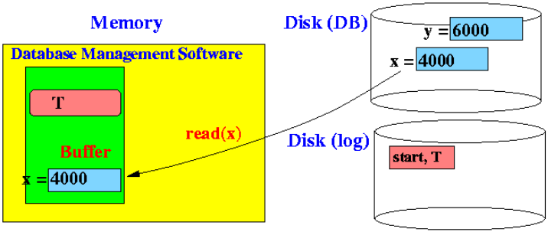
Transaction Processing is as Follows (cont.)
Step 2: Transaction T must read the data item x from disk into its memory buffer:

Slide 36
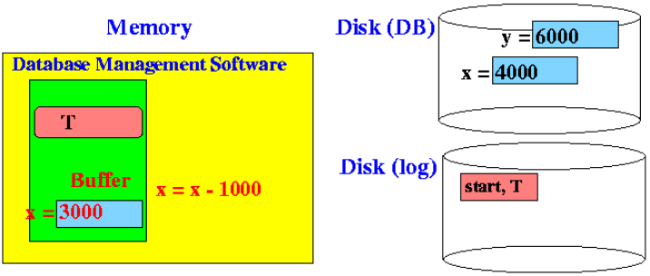
Transaction Processing is as Follows (cont.)
Step 3: To update data on disk, the transaction first update the data item x in its memory buffer

Slide 37
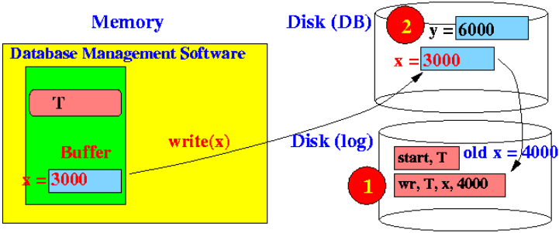
Transaction Processing is as Follows (cont.)
Step 4: Transaction T writes the data item x from its buffer to disk:
Notice that the old value of x is written to the log before writing the data item x to database
(We will soon see why the reverse will not work )

Slide 38
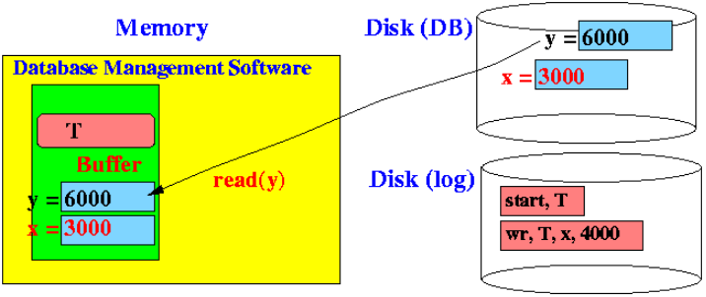
Transaction Processing is as Follows (cont.)
Step 5: Transaction T then read y from disk into its memory buffer:

Slide 39
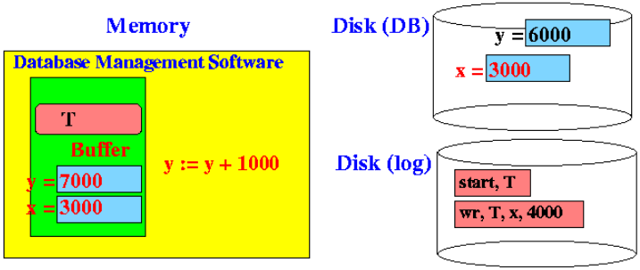
Transaction Processing is as Follows (cont.)
Step 6: T first update the data item y in its memory buffer

Slide 40
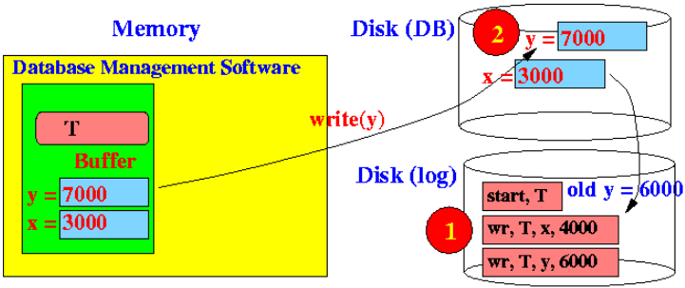
Transaction Processing is as Follows (cont.)
Step 7: Transaction T writes the data from its buffer to disk:
Again: the old value of x must be written to the log before the data item x (to database)
(The reverse will not work )

Slide 41
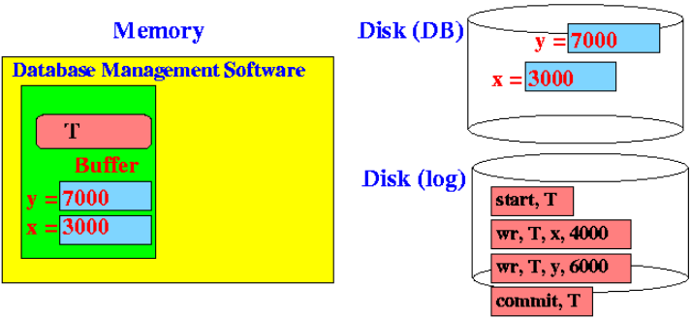
Transaction Processing is as Follows (cont.)
Step 8: Finally, transaction T completes:
Commit = a successful termination of a transaction

Slide 42
How In-Place Update + Undo Log Ensures Atomicity
Recall that the execution of a transaction is atomic:
Either everything is done (i.e., both x and y are updated)
Or else nothing is done (i.e., both x and y are NOT updated)
Question:
What can cause partial execution?
Answer: system failure
Consider a system failure occurred at some step in the above execution:

Slide 43

Consider System Failure in the Above
System failed before step 1 is complete:
x and y unchanged - no problem

Slide 44
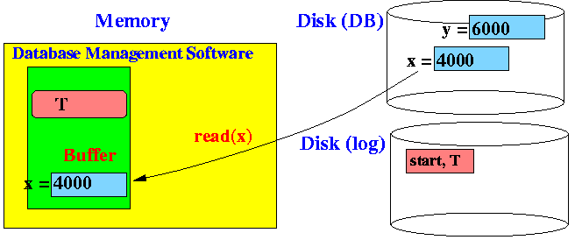
Consider System Failure in the Above (cont.)
System failed before step 2 is complete:
x and y unchanged - no problem

Slide 45

Consider System Failure in the Above (cont.)
System failed before step 3 is complete:
x and y (in the database) unchanged - no problem

Slide 46
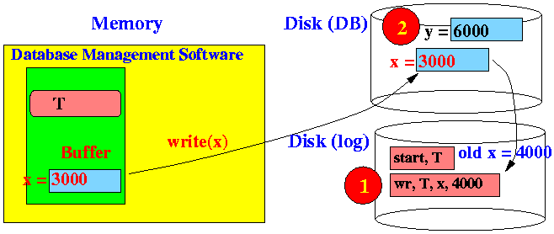
Consider System Failure in the Above (cont.)
System failed before step 4 is complete (case 1):
If system fail before writing of the log record,
then x and y (in the database) are unchanged - no problem

Slide 47
Consider System Failure in the Above (cont.)
System failed before step 4 is complete (case 2):
If system fail after writing of the log record, but before writing of the database, then:
x and y (in the database) are unchanged
However, the log contains old x = 4000
We are NOT certain whether x was modified... but we need to make sure that x gets back its original value !!!
To make certain that the transaction is atomic, we restore the value of x to its old x = 4000

Slide 48
Consider System Failure in the Above (cont.)
System failed before step 4 is complete (case 3):
If system fail after writing of the database, then:
x = 3000 and y is unchanged - We has lost $1000 !!!
Fortunately the log contains old x = 4000
We again use the log record to restore x to its original old x = 4000

Slide 49
Consider System Failure in the Above (cont.)
Note:
Here we see why we must write the log before updating the data in the database
If the data item x is updated first, and the system fails before the log is written, then we CANNOT restore x to its old value (because we don't have the log record - which could not be written because the system failed before it could write the log)

Slide 50
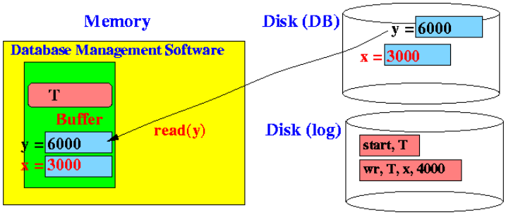
Consider System Failure in the Above (cont.)
System failed before step 5 is complete:
x = 3000 and y = 6000 - We has lost $1000 !!!
Fortunately the log contains old x = 4000
We use the log record to restore (UNDO) x to its original old x = 4000

Slide 51
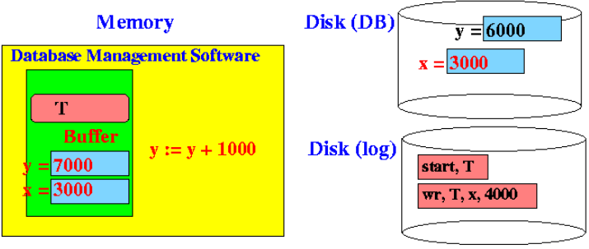
Consider System Failure in the Above (cont.)
System failed before step 6 is complete:
Same to last Step 5:
x = 3000 and y = 6000 - We has lost $1000 !!!
Fortunately the log contains old x = 4000
We use the log record to restore (UNDO) x to its original old x = 4000

Slide 52
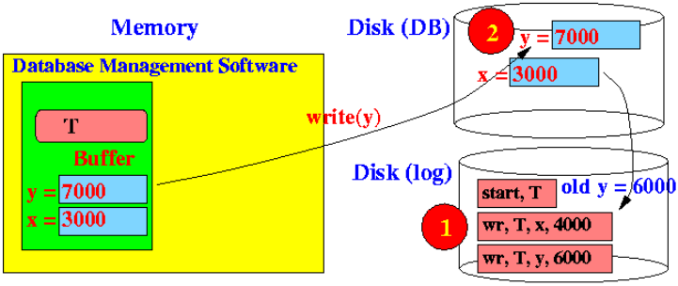
Consider System Failure in the Above (cont.)
System failed before step 7 is complete (case 1):
If system fail before writing of the log record (for y), then x = 3000 and y = 6000
We can use the log record for x to restore (UNDO) x to its original old x = 4000
We don't need to restore y!

Slide 53
Consider System Failure in the Above (cont.)
System failed before step 7 is complete (case 2):
If system fail after writing of the log record (for y), but before writing y, then:
x = 3000 and y = 6000 (in the database)
We are NOT certain whether y was modified... but we need to make sure that BOTH x AND y gets back its original value !!!
To make certain that the transaction is atomic, we restore the values of x to its old x = 4000 and y to its old y = 6000

Slide 54
Consider System Failure in the Above (cont.)
System failed before step 7 is complete (case 3):
If system fail after writing of the database, then, then:
x = 3000 and y = 7000
Although it is correct, we do NOT have any way of know that y was updated
To make certain that the transaction is atomic, we must make this choice:
Restore the values of x to its old x = 4000 and y to its old y = 6000
That's the only safe option.

Slide 55
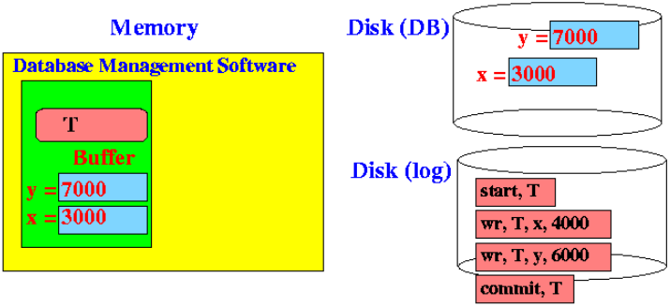
Consider System Failure in the Above (cont.)
System failed before step 8 is complete:
System failed after the COMMIT record was written
In this case, we DO have the commit record to tell us that both x and y were updated for certain !!!.
So when we see a [commit, T] record, we do NOT undo the transaction T (using the old values)

